Slide 1

HOLY MARY INSTITUTE OF TECHNOLOGY & SCIENCE (Approved by AICTE, New Delhi, Affiliated to JNTU, Hyderabad)
BOGARAM(V),KEESARA(M),MEDCHAL DISTRICT-501301
2021-2022
DEPARTMENT OF COMPUTER SCIENCE ENGINEERING
Crop Progression
By
B.Keerthana(18C91A0511)
B. Manish(18C91A0512)
K. Antony(18C91A0545)
M.Mohith(18C91A0556)
Under the guidance of:
Dr.B.Narsimha

Slide 2

Abstract
The ability to accurately estimate crop planting date and planting progression has major implication in crop management. Most of people have less knowledge of crop progression our project objective is to provide the basic information about the crop progression and to help our users in growing crop healthily and economically.
In our project we provide information about the stages of crops and the method of cultivation.

Slide 3
.
EXISTING SYSTEM:
There are lot of problems and limitations associated with existing system like UI is not at all user friendly and requires lot of effort and hard work to gain knowledge about crop cultivation and there is lot of information available in web about crop cultivation so people get confused and tired with that information and won’t be able to get interest on the agriculture and crop cultivation as searching in web is time consuming. Some sites either have the information related to land cultivation and roof gardening but not both at one place. So if the information is easily available to the user in an organized manner then it will be convenient to the user to understand and gain knowledge about crop cultivation.

Slide 4
PROPOSED SYSTEM:
Crop Progression is an android based application which is developed using kotlin ,java for logic development and XML for user interface. The proposed system will solve all the problems associated with the existing system. This application will provide complete info about crop cultivation and user can know both about land cultivation and roof gardening at one place in an organized manner with user friendly interface and it also includes features like chat bot and personal assistant which will help the user while using the app and both these features are very much useful and provides much more convenient than searching in the web about crop cultivation . And also helps the user to grow the crops in healthy and economical way and educate them in different techniques of farming based on their interest.

Slide 5
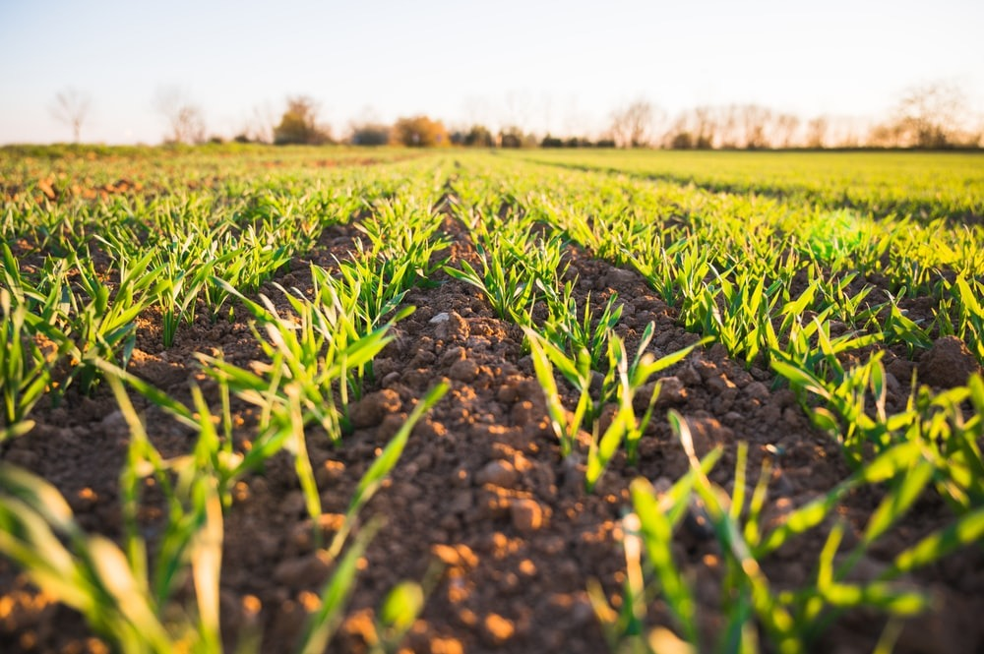
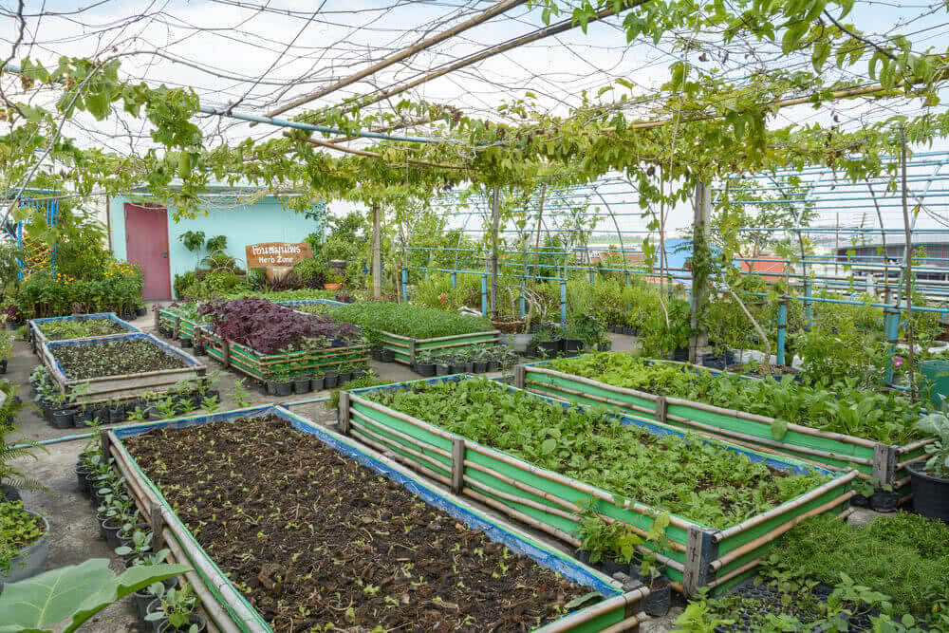
Advantages :
To educate the people who have less knowledge about farming
and help them to grow the crops in healthy and economical way
and educate them in different techniques of farming based on
their interest.
It is designed in such a way that user interface and user experience is given a high priority so that it can be used with ease.
Disadvantages:
It is specifically built for android devices only and it is not compatible with any other devices.

Slide 6
SOFTWARE REQUIREMENTS :
Operating system : Windows 10.
Coding Language : Kotlin
Editor :. Android Studio
HARDWARE REQUIREMENTS :
System : Intel i5 Core.8th gen
Hard Disk : 128 GB.
Monitor : 15’’ LED
Input Devices : Keyboard, Mouse
Ram : 8 GB

Slide 7
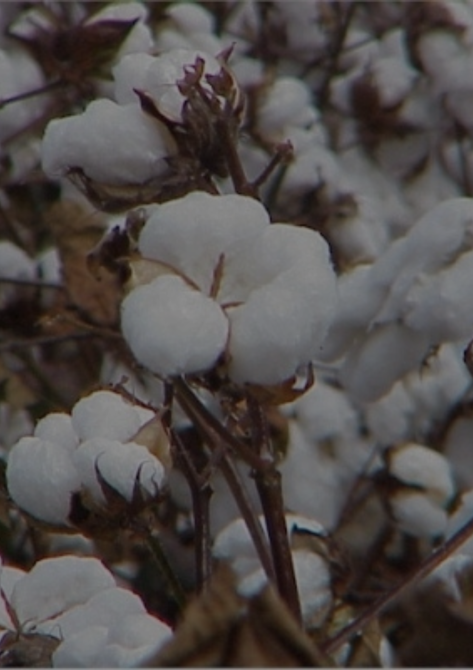
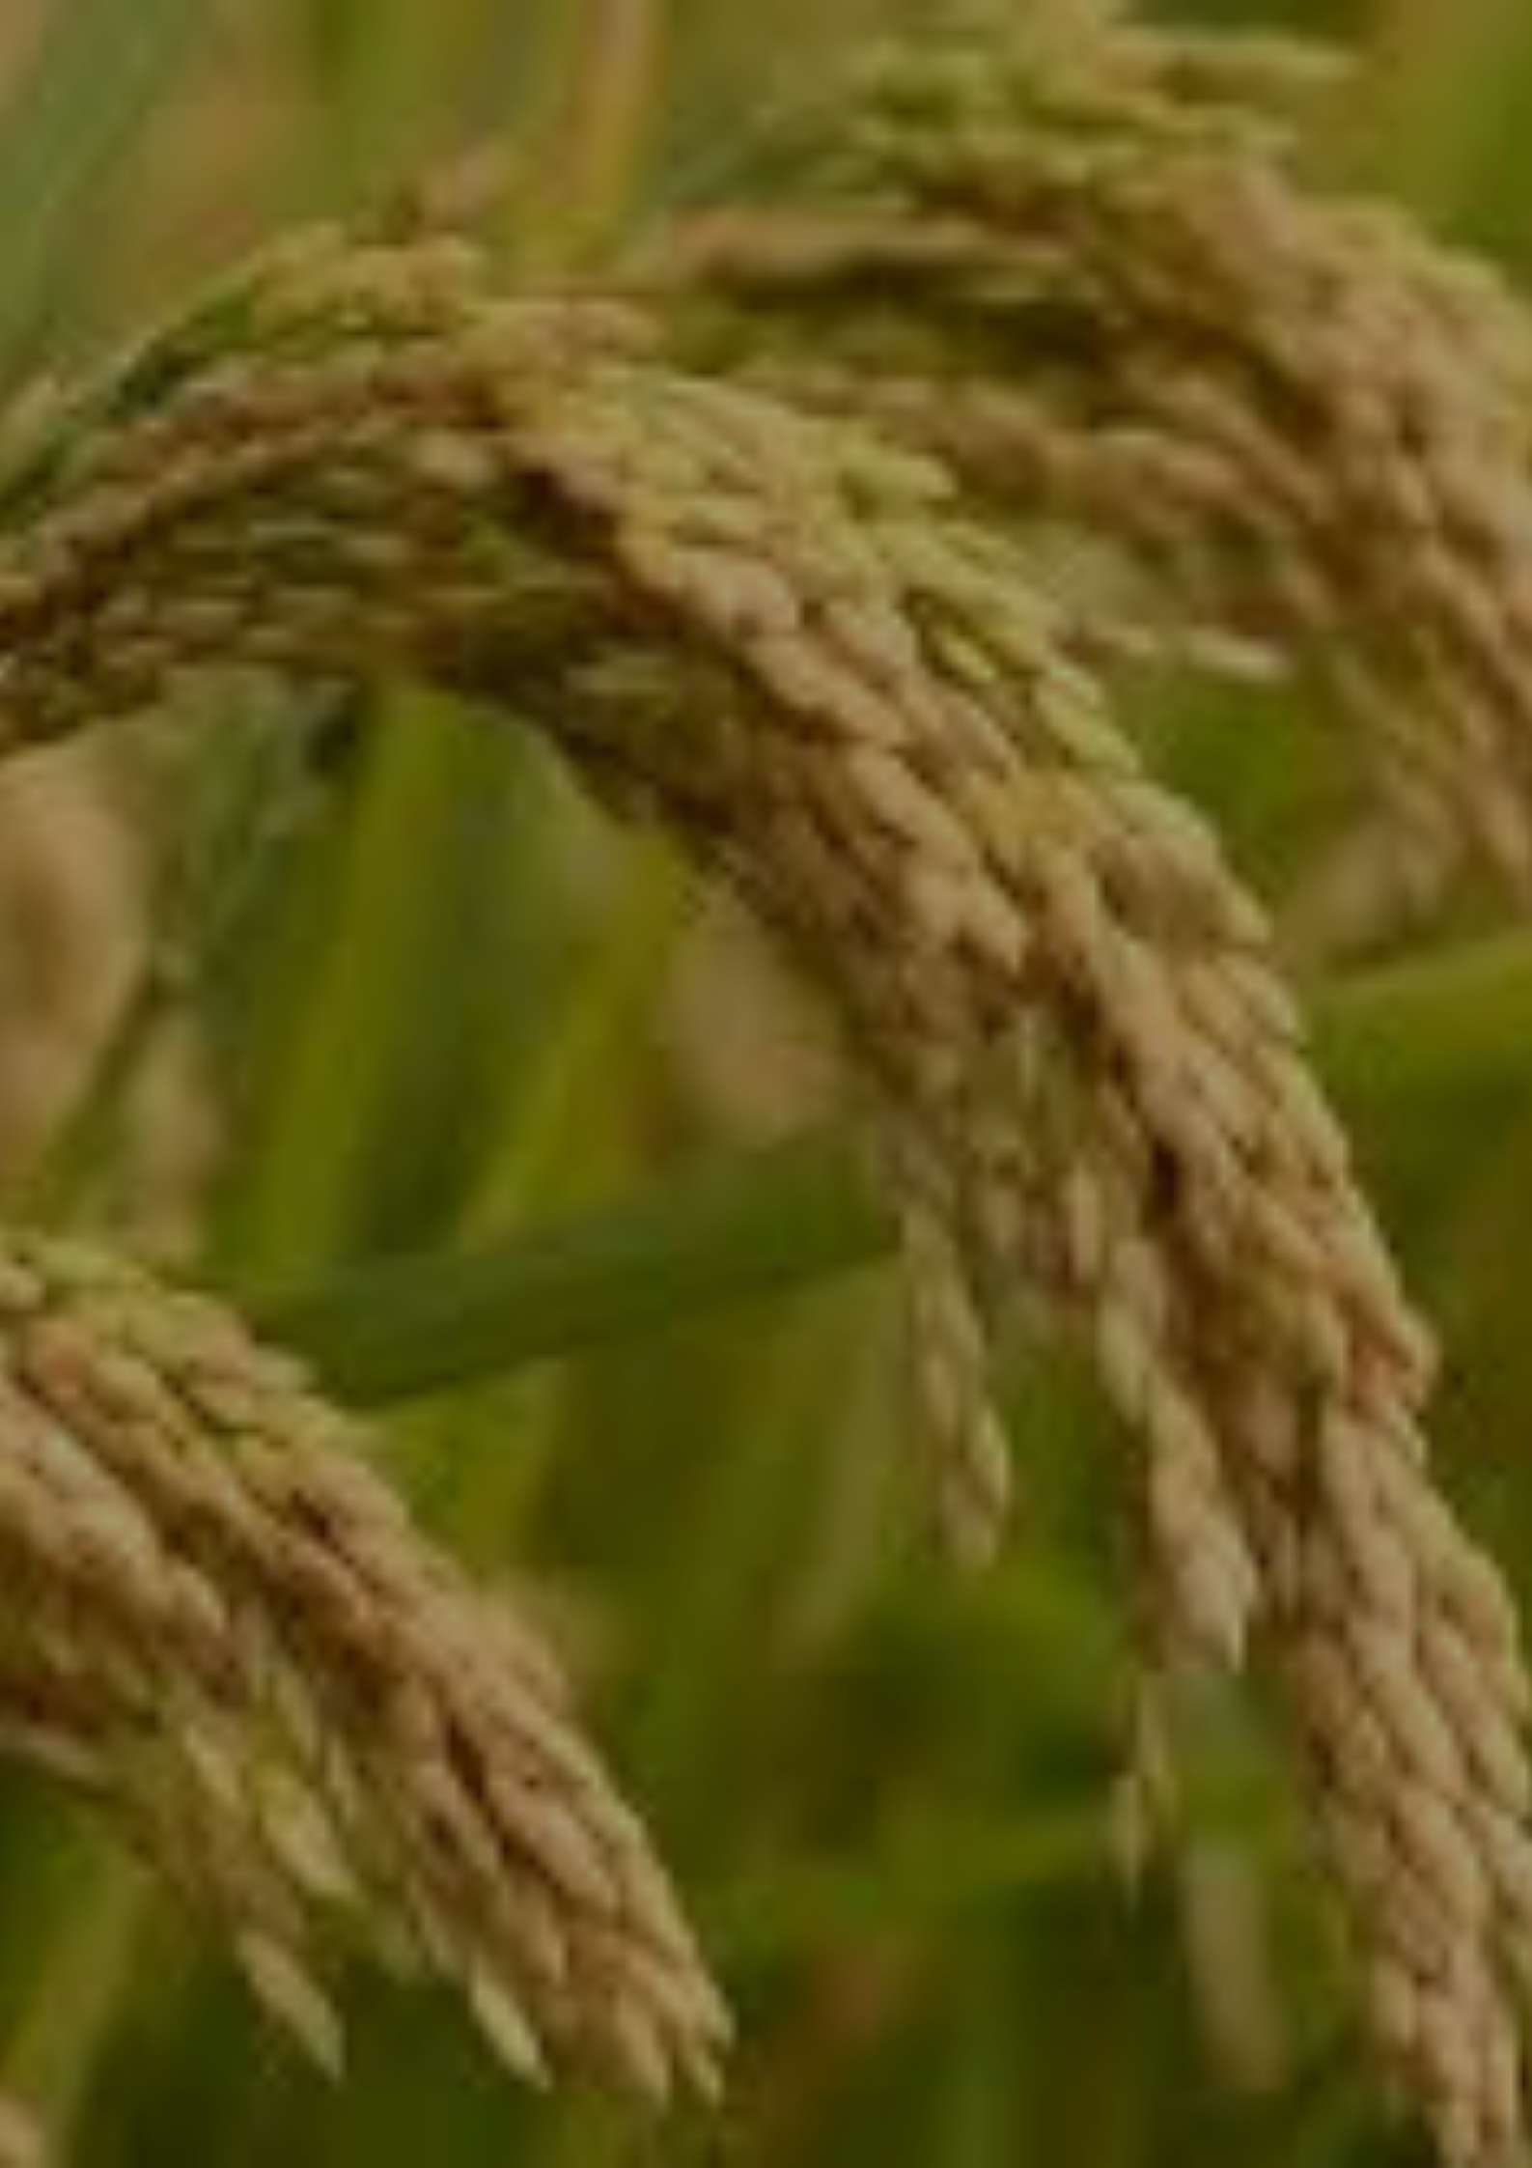
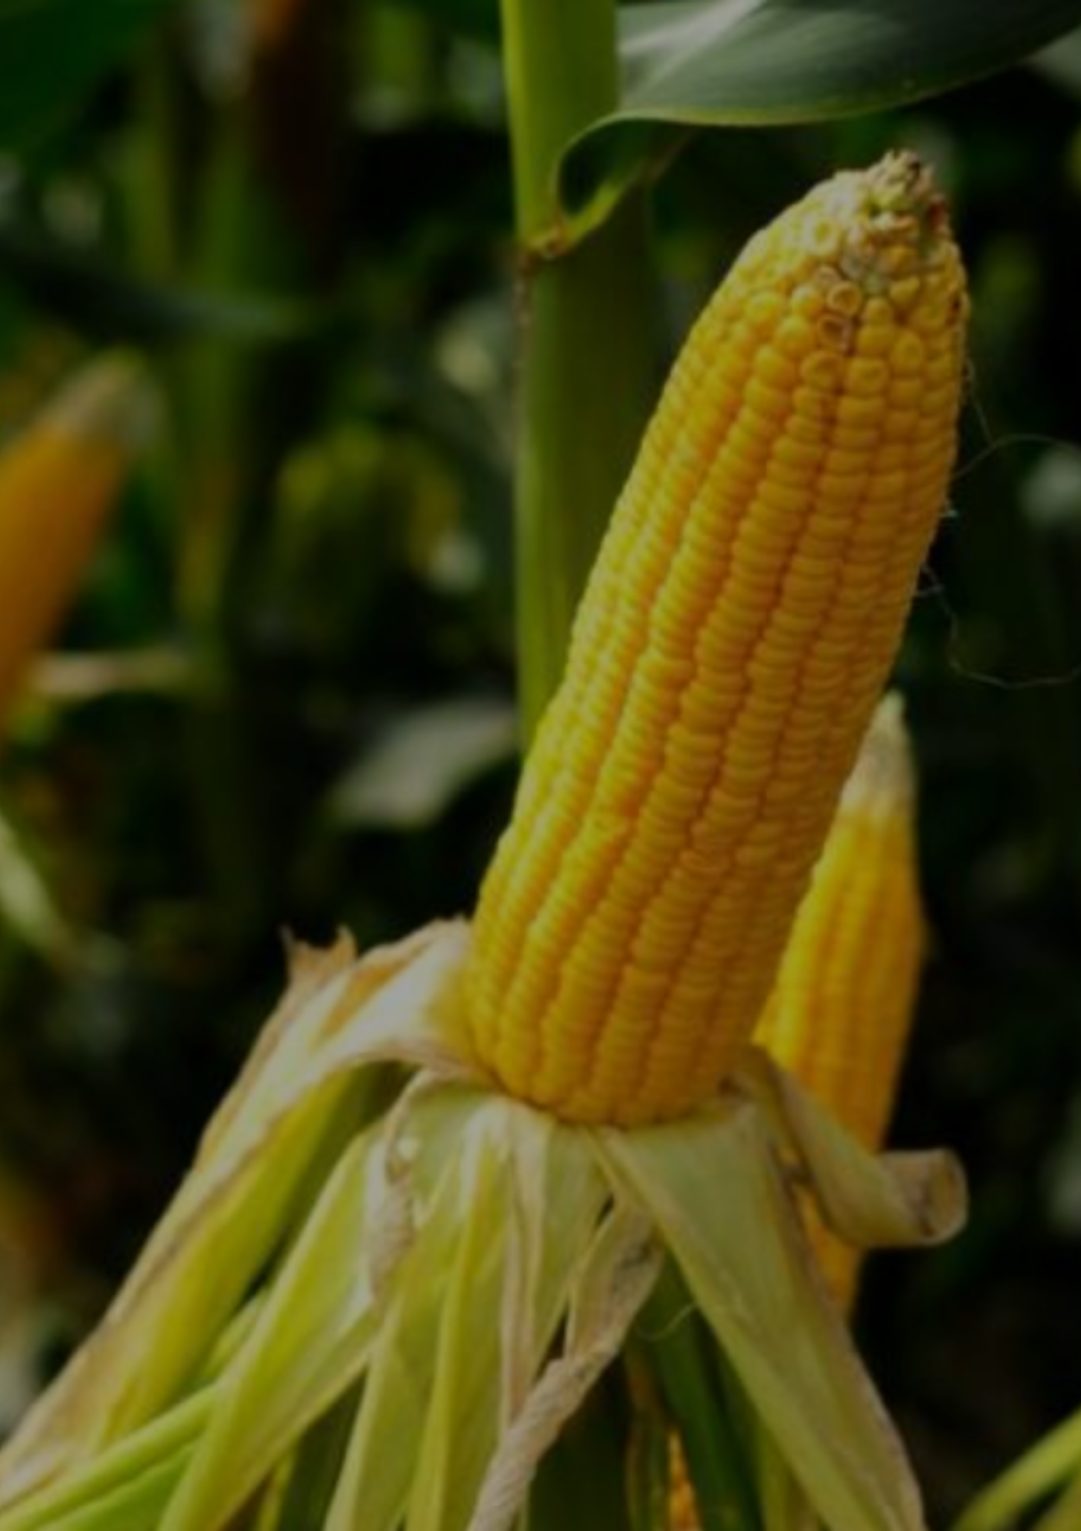
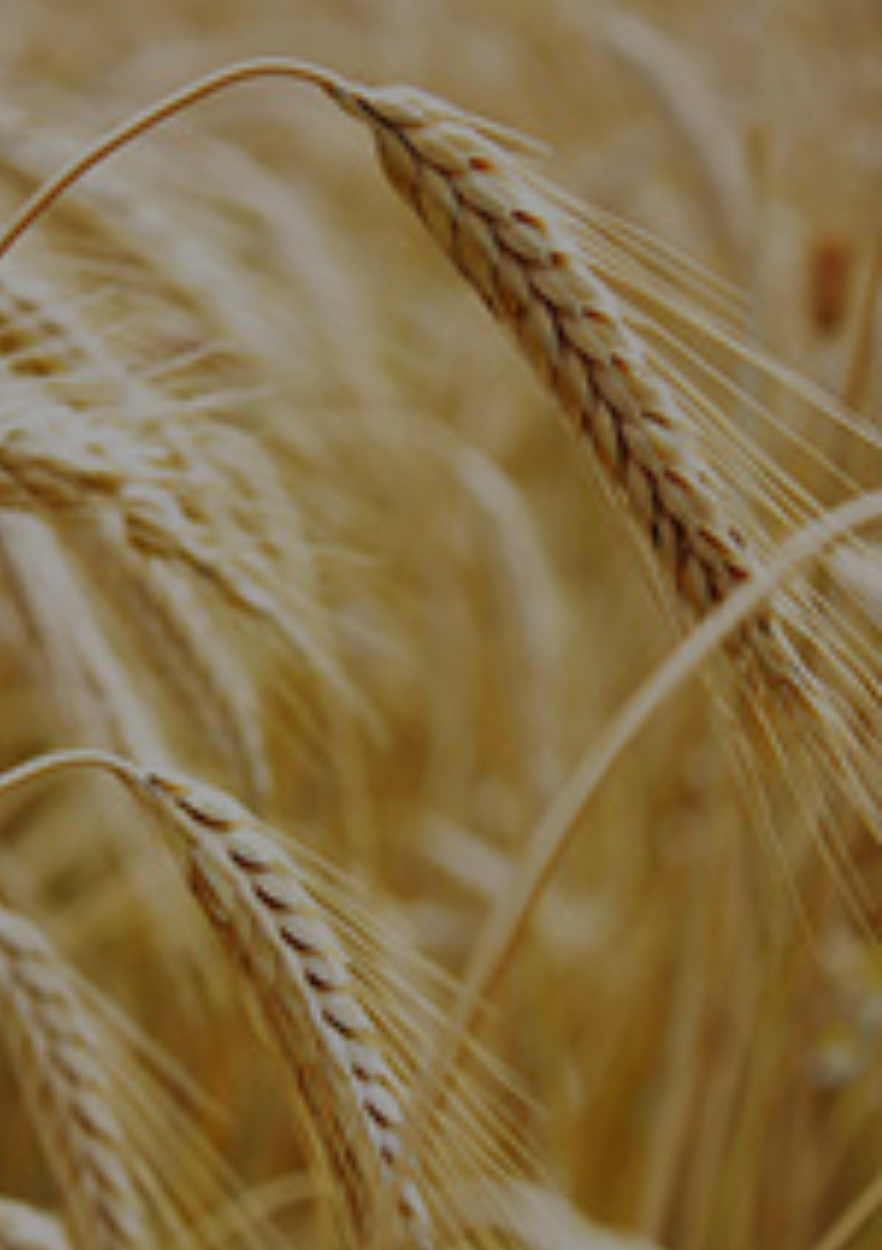
Land Cultivation
Cotton
Wheat
Rice
Maize

Slide 8
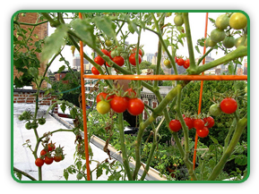
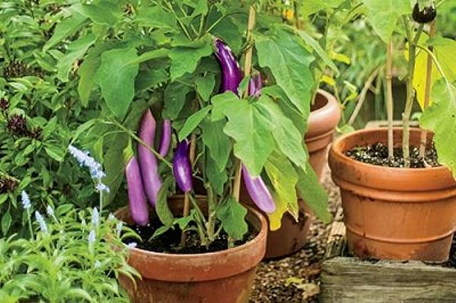
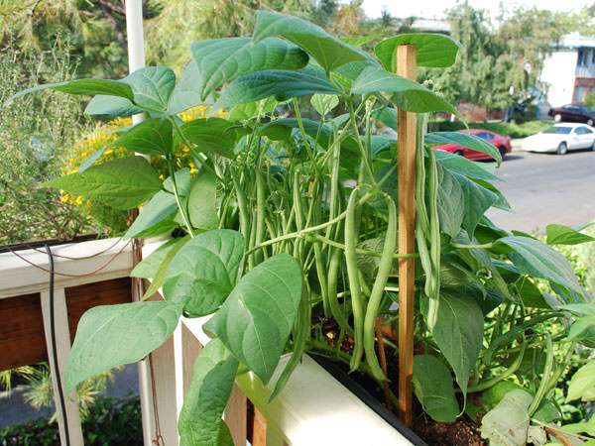
Roof Gardening
Brinjal
Tomato
Leafy Vegetables

Slide 9
CONCLUSION
As the demand for food would increase over coming years, and people have the habit to grow the crops in order to make refreshment from their daily routine, from this, they can learn the the process of growing the crops in both land and roof gardening they can also learn the new techniques evolved in the agriculture sector the people can learn by virtual assistant as well as the chat bot in coming years we can provide more features and crops regarding land and roof gardening.

Slide 10


